Slide 1
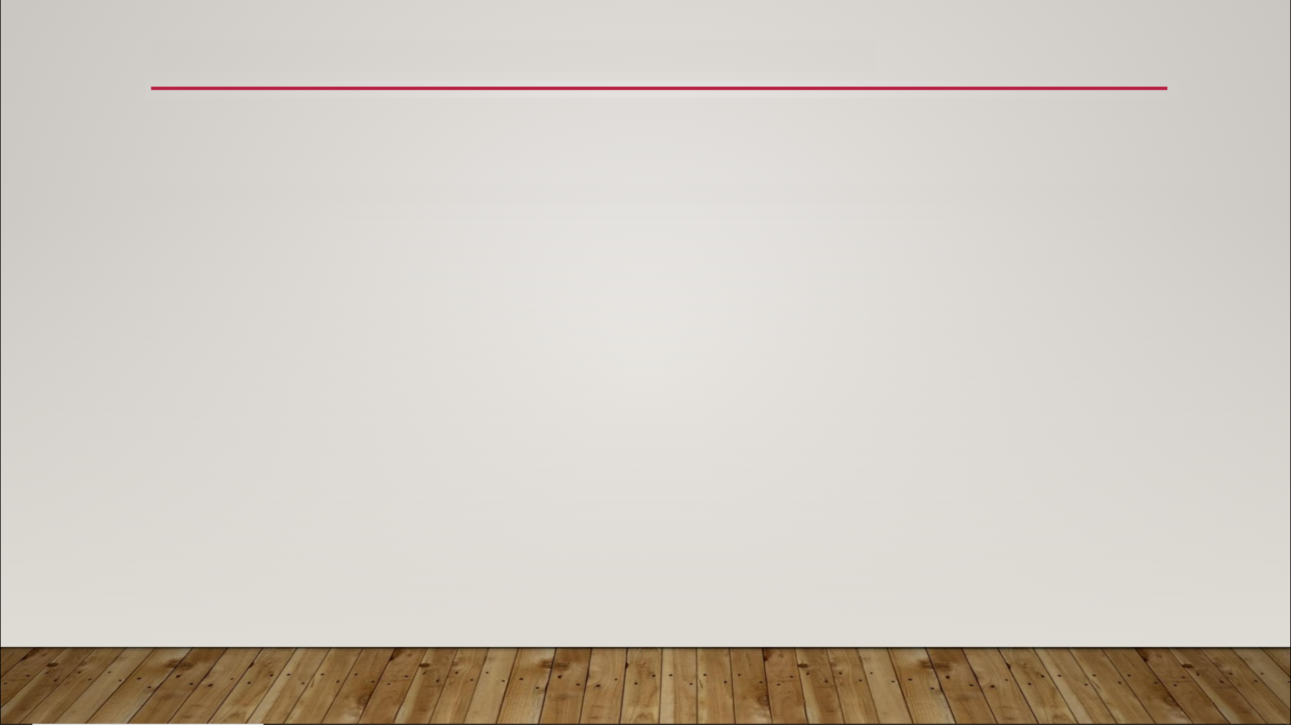
Physics Fields
Three types of Physics Fields:
Transient Fields - created and destroyed at runtime
Construction Fields - created in the Construction Script during design time after the Blueprint is compiled
Persistent Fields - remain active until removed; evaluated at every tick of gameplay

Slide 2
Physics Fields
Chaos Engine - physics engine used by Unreal
Chaos Particle - a point in space with properties such as position, orientation, velocity, and mass
Physics Type - effect that will be applied to every Chaos Particle within the field

Slide 3
Physics Fields
Physics Types
Linear Force - adds a linear force to the Particles
Linear Velocity - adds a linear velocity to the Particles
Angular Velocity - adds an angular velocity to the Particles
Angular Torque - adds an angular torque to the Particles
External Strain - can break the Particles of a Geometry Collection
Internal Strain - lowers the Damage Threshold of a Geometry Collection
Sleeping Threshold - sets Particle to sleep if its linear or angular velocity falls below specified value

Slide 4
Physics Fields
Physics Types
Disabled Threshold - disables Particle if its linear or angular velocity falls below specified value
Activate Disabled - reactivates disabled Particles
Kill Particles - disables all Particles immediately
Dynamic State - sets the states of the Particles to static, kinematic, dynamic, or sleeping
Collision Group - sets the value of the Collision Group property for the Particles

